Slide 1
﻿Bridging the Human-Task Cognitive Gap. A Theoretical Framework Applied to Medical Search
Anton van der Vegt
Thesis Review

Slide 2
motivation for this thesis

Slide 3


Our health and longevity depends on good clinical decisions
What is the diagnosis?
What medical tests to order?
What treatments to suggest?
Hmm. I’m not sure about this one
I’ve had a sore neck for 3 days and I woke up with a numb foot.
Gap in knowledge -> a clinical question -> can’t be certain of a good clinical decision
Notes:
When you front up to your GP or arrive at the emergency department of your local hospital, you are reliant upon doctors to make good decisions regarding your case, including what your diagnosis is, what tests should be ordered and what treatments you should get.
But sometimes, the doctor is unsure about a case, there may be a gap in their knowledge, and they have clinical question

Slide 4
Definition of a Clinical Question
An information need that arises as a result of a patient encounter¹ directly pertaining to the diagnosis and/or treatments for a patient condition
1. Covell DG, Uman GC, Manning PR. Information needs in office practice: are they being met? Ann Intern Med. 1985;103(4):596–9.
Notes:
When doctors are unsure, it means they lack the knowledge they require to make a certain decision
This raises a clinical question, which they need to answer to make a good decision

Slide 5
How frequently do clinical questions arise?
Hmm. I’m not sure about this one
1 question every 2 patient visits¹
1. Del Fiol G, Workman TE, Gorman PN, Workman E, Gorman PN. Clinical Questions Raised by Clinicians at the Point of Care. JAMA Intern Med. 2014;174(4):448–54.
Notes:
Studies have found that clinical questions arise at a rate of 0.2 and 0.85 questions per visit.

Slide 6
Do clinical questions get answered?
More than half (53%) of clinical questions don’t get answered¹
1. Systematic review: Del Fiol G, Workman TE, Gorman PN, Workman E, Gorman PN. Clinical Questions Raised by Clinicians at the Point of Care. JAMA Intern Med. 2014;174(4):448–54.
Notes:
When doctors are unsure, it means they lack the knowledge they require to make a certain decision
This raises a clinical question, which they need to answer to make a good decision

Slide 7
Does it matter if clinical questions are answered?
There is considerable supporting evidence that answering clinical questions leads to significant changes to the care provided to patients^{1,2,3,4,5,6,7}
﻿The Rochester study^{1,2} is an helpful exemplar
1. Marshall JG. The impact of the hospital library on clinical decision making: the Rochester study. Bull Med Libr Assoc. 1992;80(2):169.
2. Marshall JG, Sollenberger J, Easterby-Gannett S, Morgan LK, Klem M Lou, Cavanaugh SK, et al. The value of library and information services in patient care: results of a multisite study. J Med Libr Assoc JMLA. 2013;101(1):38.
3. Verhoeven AAH, Schuling J. Effect of an evidence-based answering service on GPs and their patients: a pilot study. Heal Inf Libr J. 2004;21(s2):27–35.
4. Crowley SD, Owens TA, Schardt CM, Wardell SI, Peterson J, Garrison S, et al. A Web-based Compendium of Clinical Questions and Medical Evidence to Educate Internal Medicine Residents. Acad Med. 2003;78(3):270–4.
5. Del CBM, Silagy CA, Glasziou PP, Weller D, Spinks AB, Bernath V, et al. Feasibility of an evidence-based literature search service for general practitioners. Med J Aust. 2001;175(3):134–7.
6. Schilling LM, Steiner JF, Lundahl K, Anderson RJ. Residents’ patient-specific clinical questions: opportunities for evidence-based learning. Acad Med. 2005;80(1):51–6.
7. Magrabi F, Coiera EW, Westbrook JI, Gosling AS, Vickland V. General practitioners’ use of online evidence during consultations. Int J Med Inform. 2005;74(1):1–12.
Notes:
But answering clinical questions in order to make good clinical decisions is important:
There is much evidence to show that answering clinical questions correctly makes a big difference to health outcomes.
An important study that demonstrates this is the Rochester study in the US, where 208 hospital and community based doctors provided a single clinical question and were provided with information. They report how this information changed their clinical decisions
So answering clinical questions correctly directly impacts the health outcomes of the doctor’s patients.

Slide 8
The Rochester Study
208 clinicians
hospital clinicians and family practitioners
Each provided a single clinical question for a patient case
Relevant information, pertaining to the question, was returned to the clinician
Marshall JG. The impact of the hospital library on clinical decision making: the Rochester study. Bull Med Libr Assoc. 1992;80(2):169.
2. Marshall JG, Sollenberger J, Easterby-Gannett S, Morgan LK, Klem M Lou, Cavanaugh SK, et al. The value of library and information services in patient care: results of a multisite study. J Med Libr Assoc JMLA. 2013;101(1):38.
Notes:
When doctors are unsure, it means they lack the knowledge they require to make a certain decision
This raises a clinical question, which they need to answer to make a good decision

Slide 9
Rochester Study Percent of cohort (n=208) made changes to their clinical decisions
Patient advice (72%)
Treatment decision (59%)
Choice of diagnostic test (45%)
Choice of drug (treatment) (45%)
Diagnosis decision (29%)
Correctly answering clinical questions impacts clinical decisions

Slide 10
Rochester Study Percent of cohort(n=208) avoided:
additional tests and procedures (49%)
additional outpatient visits (26%)
additional surgery (21%)
patient mortality (19%)
Correctly answering clinical questions impacts patient outcomes and the efficiency and effectiveness of the healthcare system

Slide 11
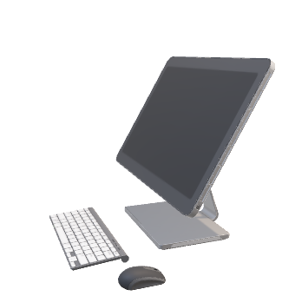

How can clinicians answer their questions?
Current medical document retrieval systems, such as PubMed, can help clinicians to answer their clinical questions.
I could search for an answer….but no time
However, they are often not used?
Clinicians report lack of time as the primary barrier to using such systems¹
1. Cook DA, Sorensen KJ, Hersh W, Berger RA, Wilkinson JM. Features of Effective Medical Knowledge Resources to Support Point of Care Learning: A Focus Group Study. 2013;
Notes:
There are existing medical document retrieval systems, such as PubMed, that can help clinician to answer their clinical questions.

Slide 12
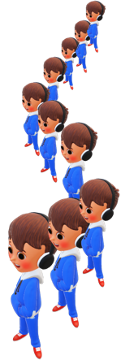
Are Clinicians Time Pressured?
Average consultation time across more than half of the world’s population is less than 5 minutes¹
﻿Across ten industrialized countries, over one-third of all primary care physicians are dissatisfied with the time available per patient²
Umm. I have to make a decision fast
I’ve had a sore neck for 3 days and I woke up with a numb foot.
Clinicians frequently operate under time pressure
1. Irving G, Neves AL, Dambha-Miller H, Oishi A, Tagashira H, Verho A, et al. International variations in primary care physician consultation time: a systematic review of 67 countries. BMJ Open. 2017;7(10):e017902.
2. Osborn R, Moulds D, Schneider EC, Doty MM, Squires D, Sarnak DO. Primary care physicians in ten countries report challenges caring for patients with complex health needs. Health Aff. 2015;34(12):2104–12.
Notes:
And clinicians are often time pressure, as reported in the literature.
These are just some of the figures – but many surveys point to high time pressure for doctors

Slide 13
Thesis Objective
This thesis directs its investigations to the ﻿time and knowledge limitations of clinicians
﻿specifically, how minimal interaction information retrieval (IR) can be brought to bear on these limitations to enable more effective clinical decisions.
Notes:
4:20 minutes to end of this

Slide 14

Thesis Objective
This thesis directs its investigations to the ﻿time and knowledge limitations of clinicians
﻿specifically, how minimal interaction information retrieval (IR) can be brought to bear on these limitations to enable more effective clinical decisions.
Notes:
Before we can this thesis, we need to define the concept of minimal interaction IR
as it is central to this thesis

Slide 15
Multiple Interaction IR (multi-IIR) vs Minimal Interaction IR (mini-IIR)

Slide 16
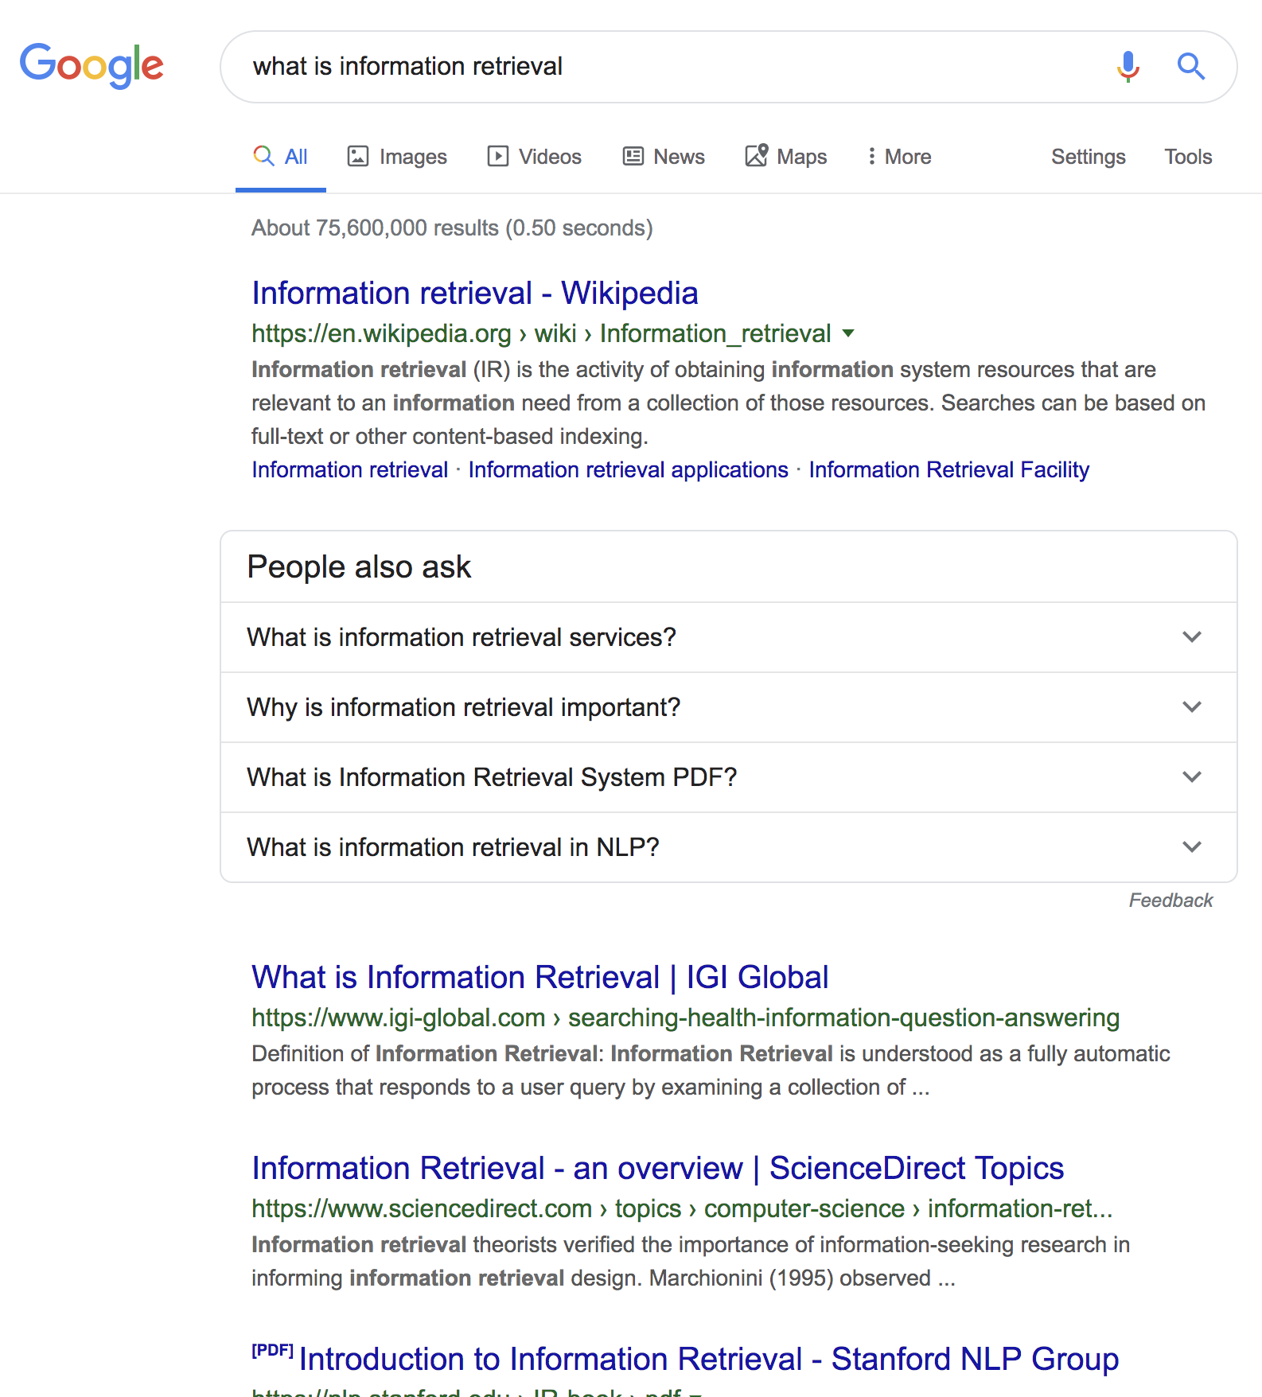
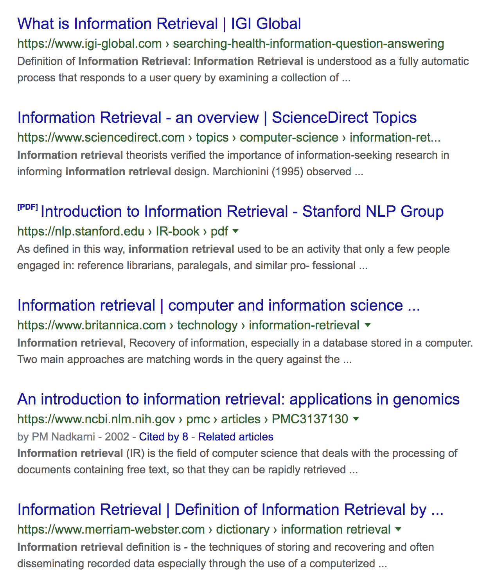



Multiple Interaction IR (multi-IIR)
1. User Query
Most contemporary information search is conducted using document retrieval methods
Document retrieval is a multiple interaction IR scenario. User:
Submits query
Reviews SERP
Selects document
Reads document
Repeat (1) – (5) until information need is satisfied
2. Review SERP: Search Engine Results Page
Commercial search uses multi-IIR methods
3. Select and read document/web page

Slide 17
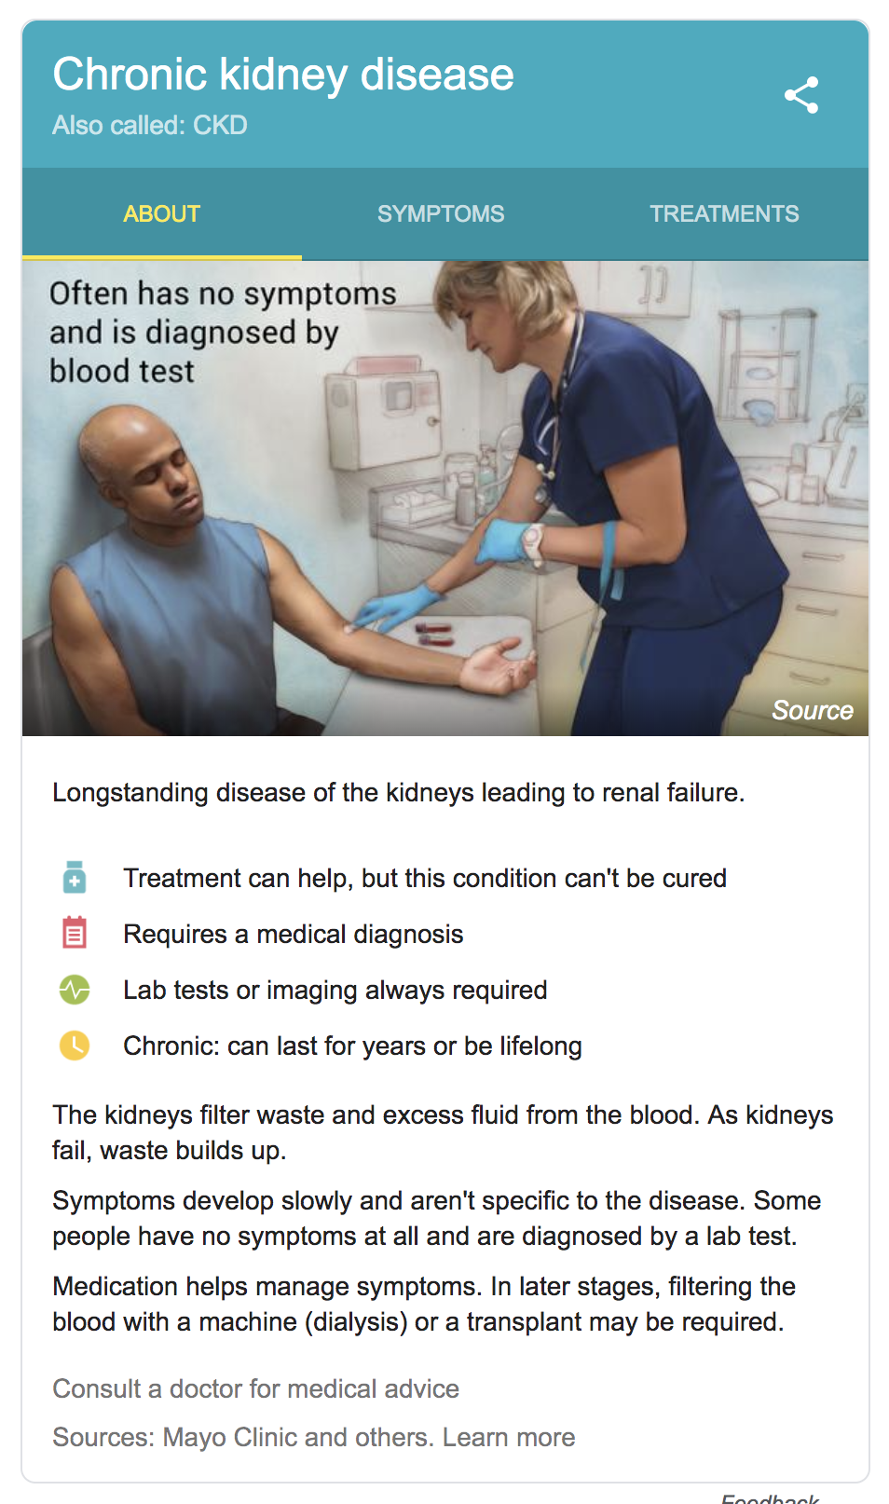
Minimal Interaction IR (mini-IIR)
In a minimal interaction IR scenario the user:
Enters a search query
Receives an information object
An answer, or
Synthesized information on an answer card (picture to right)
May be text, picture or voice
Growing use-case
Small smart phone screen search
Voice activated search
Google Answer Card¹ for search query: Kidney Disease
1. Sourced on 4/10/2019: https://www.google.com/search?q=kidney+disease&rlz=1C5CHFA_enAU789AU790&oq=kidney+dise&aqs=chrome.0.0j69i57j0l4.3487j0j4&sourceid=chrome&ie=UTF-8

Slide 18
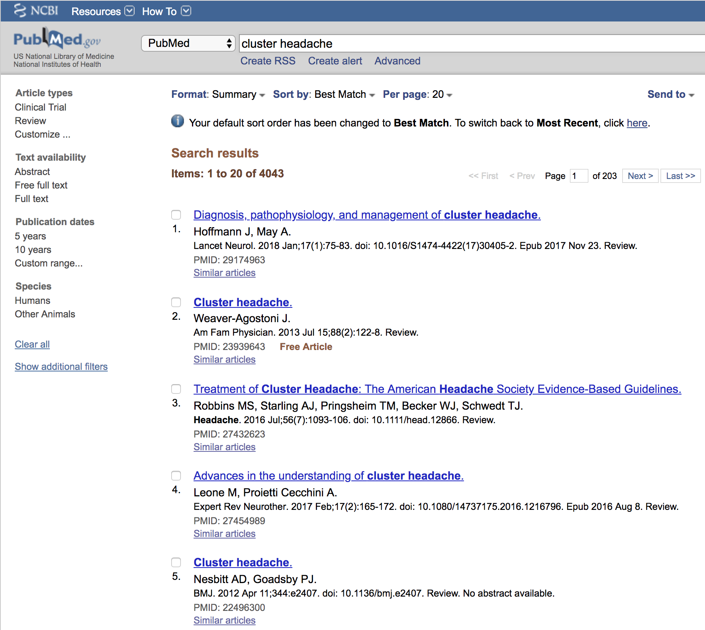

Clinical search using PubMed
PubMed also uses a document retrieval approach.
currently over 30 million citations¹.
Widely used:
3.3billion searches in 2017²
75%-80% of clinicians in USA, UK and Canada
Scientific Medical Literature = journals, conferences, clinical trials etc
PubMed uses multi-IIR methods
Source accessed 4/10/2019: https://www.ncbi.nlm.nih.gov/pubmed
Source accessed 4/10/2019: https://wayback.archive-it.org/org-350/20190414183903/https://www.nlm.nih.gov/bsd/bsd_key.html
Davies KS. Physicians and their use of information: a survey comparison between the United States, Canada, and the United Kingdom. J Med Libr Assoc. 2011;99(1):88–91. doi:10.3163/1536-5050.99.1.015

Slide 19
But for time-pressured clinicians…
Is document retrieval, such as PubMed, still effective?
I could search for an answer….but no time
Notes:
There are existing medical document retrieval systems, such as PubMed, that can help clinician to answer their clinical questions.

Slide 20


But for time-pressured clinicians…
Is document retrieval, such as PubMed, still effective?
Could a minimal interactive IR system be more effective?
Enable faster answer retrieval?
Less time to answer
= lower barrier to use = more clinical questions answered
= Better patient care and more efficient healthcare service
Notes:
There are existing medical document retrieval systems, such as PubMed, that can help clinician to answer their clinical questions.

Slide 21
In Summary
Clinicians raise lots of clinical questions
Most clinical questions never get pursued
But Answering clinical questions underpins patient outcomes and an efficient and effective healthcare system
Clinicians can use systems, such as PubMed to help them answer their questions, but often don’t have enough time
Medical search systems, like Pubmed are multi-IIR
We wonder how effective multi-IIR systems, like PubMed, are for time pressure clinicians and whether mini-IIR systems might be better?
We wonder
Notes:
I think it took about 10 minutes to here.

Slide 22
Thesis Overview
Notes:
10 mins to here

Slide 23
Thesis Overview Diagram
Relationship Scoring
Empirical Evaluation
Relationship Extraction
Empirical Evaluation
Clinical Decision Support
User Study
Instantiation Method
Empirical Evaluation
Case-Based Problem Resolution Model
Information Retrieval Theory
Multiple Interaction IR
Minimal Interaction IR
Bridging Information Retrieval Conceptual Framework
Notes:
The diagram shows the two domains that this thesis operates within – IR and CDS
40 minutes is insufficient to cover the entire thesis in detail, so I am going to provide you with the research questions, together with the findings and contributions up front and then we will take a more detailed look into two specific areas.
The thesis begins here (click)

Slide 24

Thesis Overview Diagram
RQ-1: How effective are document retrieval solutions, at helping time-pressured clinicians to answer their clinical questions?
Relationship Scoring
Empirical Evaluation
Relationship Extraction
Empirical Evaluation
Clinical Decision Support
User Study
Instantiation Method
Empirical Evaluation
Case-Based Problem Resolution Model
Information Retrieval Theory
Multiple Interaction IR
Minimal Interaction IR
Bridging Information Retrieval Conceptual Framework
Notes:
The diagram shows the two domains that this thesis operates within – IR and CDS
40 minutes is insufficient to cover the entire thesis in detail, so I am going to provide you with the research questions, together with the findings and contributions up front and then we will take a more detailed look into two specific areas.
The thesis begins here (click)

Slide 25

Study Highlights: RQ-1
How effective are document retrieval solutions, that draw from scientific medical literature, at helping time-pressured clinicians to answer their clinical questions?

Slide 26
Study Specific Research Questions
﻿RQ-1.1: Does the use of a document retrieval search system enable clinicians to make better clinical decisions?
﻿RQ-1.2: How does time pressure impact clinical decision making?
﻿RQ-1.3: Does a significantly better search system translate to better and faster clinical decisions?

Slide 27
Overall Study Design
85 final year medical students, 16 doctors and 8 nurses
16 questions: 1,653 samples
Answer= Yes, No, Conflicting
Questions are ﻿real-life scenarios, e.g.,
﻿A 48 year old man presents with severe right sided loin pain and is diagnosed with a 4mm distal ureteric calculus. Has Tamsulosin been shown to increase the chances of the calculus passing?

Slide 28

Study Specific Research Questions
﻿RQ-1.1: Does the use of a document retrieval search system enable clinicians to make better clinical decisions?
﻿RQ-1.2: How does time pressure impact clinical decision making?
﻿RQ-1.3: Does a significantly better search system translate to better and faster clinical decisions?

Slide 29
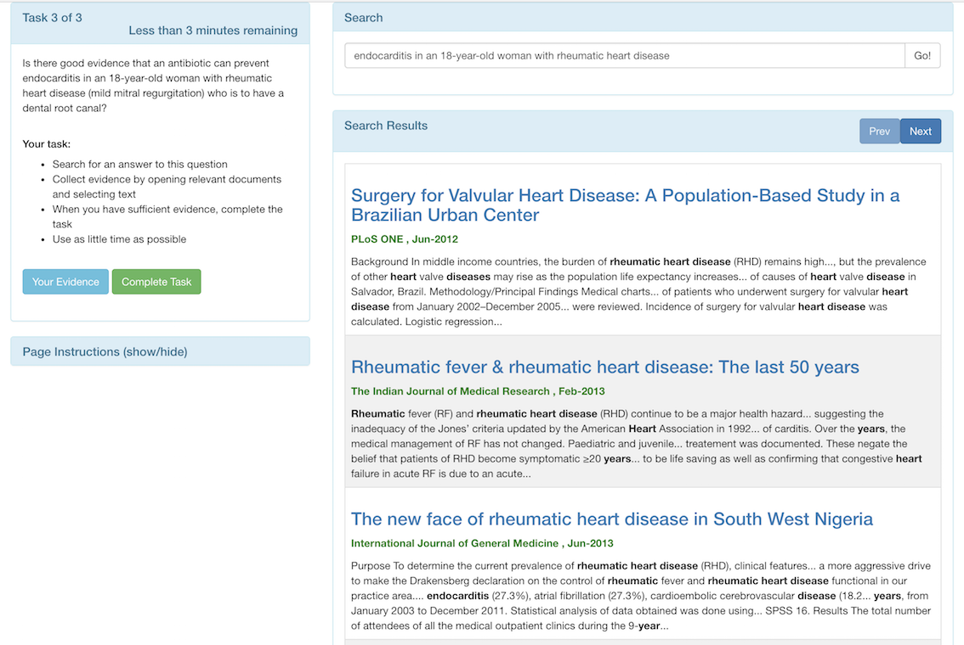
Document Retrieval Medical Search System
Multi-Interaction IR

Slide 30
Similar Prior Studies
Westbrook et al¹: 75 clinicians, 8 clinical questions
Hersh et al²: 45 medical students, 21 nursing students, total 324 questions
Westbrook JI, Coiera EW, Gosling AS. Do online information retrieval systems help experienced clinicians answer clinical questions? J Am Med Informatics Assoc. 2005;12(3):315–2
Hersh WR, Crabtree MK, Hickam DH, Sacherek L, Friedman CP, Tidmarsh P, et al. Factors associated with success in searching MEDLINE and applying evidence to answer clinical questions. J Am Med Informatics Assoc. 2002;9(3):283–93.

Slide 31


Our Results Does a search system help clinicians to answer their clinical questions?
Around half the questions answered incorrectly
Slightly higher pre-search correct answer rate
Slightly higher post-search correct answer rate
Similar significant benefit from using a medical search system
Yes.....but
Note: All differences between pre-search and post-search answers are significant (﻿McNemar's Chi-squared Test for symmetry)

Slide 32

Study Specific Research Questions
﻿RQ-1.1: Does the use of a document retrieval search system enable clinicians to make better clinical decisions?
﻿RQ-1.2: How does time pressure impact clinical decision making?
﻿RQ-1.3: Does a significantly better search system translate to better and faster clinical decisions?

Slide 33
Prior Studies
Westbrook et al¹: 75 clinicians, 8 clinical questions
Hersh et al²: 45 medical students, 21 nursing students, total 324 questions
Crescenzi et al³: Impact of time constraints on user during information search.
Users report:
Greater time pressure
Higher perceived task difficulty
Less satisfaction with their performance
80 minutes for 8 questions – not policed.
No time constraint
Westbrook JI, Coiera EW, Gosling AS. Do online information retrieval systems help experienced clinicians answer clinical questions? J Am Med Informatics Assoc. 2005;12(3):315–2
Hersh WR, Crabtree MK, Hickam DH, Sacherek L, Friedman CP, Tidmarsh P, et al. Factors associated with success in searching MEDLINE and applying evidence to answer clinical questions. J Am Med Informatics Assoc. 2002;9(3):283–93.
Crescenzi A, Kelly D, Azzopardi L. Impacts of time constraints and system delays on user experience. In Association for Computing Machinery, Inc; 2016. p. 141–50.

Slide 34
Study Design
Search time constraints applied to induce time pressure
Based on Westbrook et al.: mean search time = 6.1mins, std. dev = 3 mins. Therefore, 3 Time constraints applied to search: 3 minute, 6 minute and 9 minute
Within-subject, time constraint changes each question
Participant is notified of time at start of each question, then given a minute-by-minute countdown timer, then warning at 30 seconds to go, then forced to stop and answer question when time is up
Westbrook JI, Coiera EW, Gosling AS. Do online information retrieval systems help experienced clinicians answer clinical questions? J Am Med Informatics Assoc. 2005;12(3):315

Slide 35

How we measure Impact of Time Pressure on Decision Quality
On Answer Correctness
Post-search correct answer rate
On Answer Direction
From right/wrong pre-search to right/wrong post-search
On the Participant
Answer confidence, perceived difficulty and stress
On Search Behavior
# of searches, documents read, read time etc

Slide 36
Impact of time pressure
Percent of Participants
Step by Step

Slide 37
Correctness before search
No significant differences
Percent of Participants
Right before using search system
I.e., before using the search system

Slide 38


Right before search, then wrong after
More people incorrectly changed their answer after using search system
Percent of Participants
Increases with increased time pressure

Slide 39


Wrong before search then right
Less people Used could use search system to make better decisions
Percent of Participants
Decreases with increased time pressure

Slide 40

Right after using search system
Significantly less questions answered correctly
Benefits of document retrieval is significantly eroded by time-pressure
Percent of Participants
Decreases with increased time pressure

Slide 41
Impact of time pressure
Significantly less questions answered correctly with the aid of the search system
Similar pre-search results (no sig. differences)
Less participants able to use the search system to change their incorrect pre-search answer
More people incorrectly changing their answer after search
Significantly erodes the benefit from the search system

Slide 42
How we measure Impact of Time Pressure on Decision Quality
On Answer Correctness
Post-search correct answer rate
On Answer Direction
From right/wrong pre-search to right/wrong post-search
On the Participant
Answer confidence, perceived difficulty and stress
On Search Behavior
# of searches, documents read, read time etc

Slide 43



Impact of Time Pressure on the Participant
Decreased answer confidence
Increased task difficulty
Increased stress
Note: All differences between time pressure levels are significant (TukeyHSD p<.05)

Slide 44

How we measure Impact of Time Pressure on Decision Quality
On Answer Correctness
Post-search correct answer rate
On Answer Direction
From right/wrong pre-search to right/wrong post-search
On the Participant
Answer confidence, perceived difficulty and stress
On Search Behavior
# of searches, documents read, read time etc
Time pressure occurs because of increased numbers of searches, documents read, search time, read time and depth of search

Slide 45
Conclusions
﻿RQ-1.1: Does the use of a document retrieval search system enable clinicians to make better clinical decisions?
﻿RQ-1.2: How does time pressure impact clinical decision making?
﻿RQ-1.3: Does a significantly better search system translate to better and faster clinical decisions?
Yes
Significantly erodes the benefits of a doc. retrieval system
Compared 2 systems: BM25 retrieval & state-of-art medical doc. retrieval for similar task
Sig. difference in off-line traditional IR performance, e.g., +73% MAP
No/Minimal Impact
Notes:
15 minutes to complete this study.

Slide 46


Why do clinicians fail to correctly answer around half the questions?
Around half the questions answered incorrectly
Is it because of:
the corpus?
the search system?
the participant?
Factor analysis of Failures
Note: All differences between pre-search and post-search answers are significant (﻿McNemar's Chi-squared Test for symmetry)

Slide 47
Success Factor Model: Key Assumption
Clinician viewed document and set relevance = Essential
Clinician got Wrong-Right Answer
=
Turning Point Documents
Clinician got Wrong Post-Search Answer
=
Derailing Documents
Define 2 types of documents:
Turning Point
Derailing
Define factors based on these docs.

Slide 48
The Success Factors

Slide 49
The Success Factors

Slide 50
The Success Factors

Slide 51
The Success Factors

Slide 52
The Success Factors

Slide 53
The Success Factors

Slide 54
The Success Factors
Each factor has 3 grades
Green: Above normal (+1SD)
Amber: normal
Red: below normal (-1SD)

Slide 55
Corpus
Taskiir System
Participant
view Question
P1
Available Documents
Read question
Search for docs
Submit Query
S1
P2
Stage 2
C1-C4
Provide SERP
Submit Query
Review SERP
Corpus Success Factors:
C1: corpTPDoc - # base turning point docs.
C2: corpDRDoc - # derailing docs.
C3: corpPCTDoc - % base turning point docs.
C4: corpAmbDoc - # ambiguous docs.
Search System Success Factor:
S1: searchEff – search system effectiveness
Participant Success Factors:
P1: partPK - Prior knowledge
P2: partQEff - Query formulation ability
P3: partTPDoc - # turning point docs. selected
P4: partDRDoc - # derailing docs. selected
P5: partPCTDoc - % turning point docs. selected
P6: partDocInt – Doc. interpretation ability
P3- P5
No
Open Doc?
Yes
Read/View & Assess Doc
P6
Finished?
No
Yes
Answer

Slide 56
Corpus
Taskiir System
Participant
view Question
P1
Available Documents
Read question
Search for docs
Submit Query
S1
P2
Stage 2
C1-C4
Provide SERP
Submit Query
Review SERP
Corpus Success Factors:
C1: corpTPDoc - # base turning point docs.
C2: corpDRDoc - # derailing docs.
C3: corpPCTDoc - % base turning point docs.
C4: corpAmbDoc - # ambiguous docs.
Search System Success Factor:
S1: searchEff – search system effectiveness
Participant Success Factors:
P1: partPK - Prior knowledge
P2: partQEff - Query formulation ability
P3: partTPDoc - # turning point docs. selected
P4: partDRDoc - # derailing docs. selected
P5: partPCTDoc - % turning point docs. selected
P6: partDocInt – Doc. interpretation ability
P3- P5
No
Open Doc?
Yes
Read/View & Assess Doc
P6
Finished?
No
Yes
Answer

Slide 57
The Success Factors
Which Factors are most important?
Factors are listed around the radar graph

Slide 58


The Success Factors
Which Factors are most important?
All participant questions answered correctly post-search
All participant questions answered incorrectly post-search

Slide 59

The Success Factors
Which Factors are most important?
The scale:
Ratio of Green graded factors to Red graded factors. The more positive, the more green graded tasks in that cohort for that factor

Slide 60
The Success Factors
Which Factors are most important?
The bigger the gap, the greater the difference in that factor between success and failure

Slide 61




The Success Factors
Document interpretation is the most important factor
Document Interpretation = Read more turning point documents that derailing documents, but get a wrong answer
Poor document interpretation is the greatest factor accounting for failure

Slide 62
The Success Factors
Participant document interpretation (partDocInt) is most significant factor accounting for failure
All participant questions answered correctly post-search
The scale:
Ratio of Green graded factors to Red graded factors. The more positive, the more green graded tasks in that cohort for that factor
All participant questions answered incorrectly post-search
Document Interpretation = Read a turning point document, that others used to answer correctly but, it was used to get a wrong answer
Poor document interpretation is the greatest factor accounting for failure
The bigger the gap, the greater the difference in that factor between success and failure
Factors are listed around the radar graph

Slide 63
RQ-1: Selected Key Findings
﻿Document retrieval systems help clinicians make better clinical decisions
﻿Time pressure erodes the benefit
﻿Better retrieval models have minimal impact
The largest factor impacting failure is ability to interpret documents

Slide 64
Is Mini-IIR a better approach?
Requires less time to search for answers?
Requires less document interpretation?
Notes:
23 minutes to here

Slide 65

Thesis Overview Diagram
Relationship Scoring
Empirical Evaluation
Relationship Extraction
Empirical Evaluation
Clinical Decision Support
RQ-1
User Study
Instantiation Method
Empirical Evaluation
Case-Based Problem Resolution Model
Information Retrieval Theory
Multiple Interaction IR
Minimal Interaction IR
RQ-2: ﻿What are the key elements of an IR conceptual framework that supports and distinguishes between minimal and multi-interaction search tasks?
Bridging Information Retrieval Conceptual Framework
Notes:
The diagram shows the two domains that this thesis operates within – IR and CDS
40 minutes is insufficient to cover the entire thesis in detail, so I am going to provide you with the research questions, together with the findings and contributions up front and then we will take a more detailed look into two specific areas.
The thesis begins here (click)

Slide 66
RQ-2: Selected Key Contributions
Novel conceptual IR framework: Bridging Information Retrieval
﻿Method to identify search task category (hunting, informing, entertaining) and thereby specify the resolution method; i.e., minimal or multiple interaction IR
Please refer to Chapter 5

Slide 67

Thesis Overview Diagram
Relationship Scoring
Empirical Evaluation
RQ-3: ﻿What are the key elements of a minimal interaction IR retrieval system to help clinicians to answer their clinical questions?
Relationship Extraction
Empirical Evaluation
Clinical Decision Support
RQ-1
User Study
Instantiation Method
Empirical Evaluation
Case-Based Problem Resolution Model
Information Retrieval Theory
Multiple Interaction IR
Minimal Interaction IR
RQ-2
Bridging Information Retrieval Conceptual Framework
Notes:
The diagram shows the two domains that this thesis operates within – IR and CDS
40 minutes is insufficient to cover the entire thesis in detail, so I am going to provide you with the research questions, together with the findings and contributions up front and then we will take a more detailed look into two specific areas.
The thesis begins here (click)

Slide 68
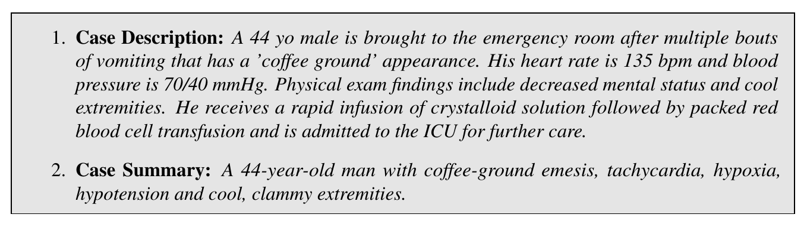
Objective of Minimal Interaction IR Model
To resolve medical case-based problems (clinical question)
Also called Answer Retrieval

Slide 69
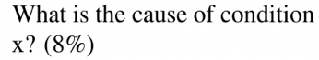
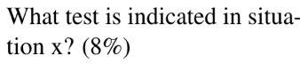
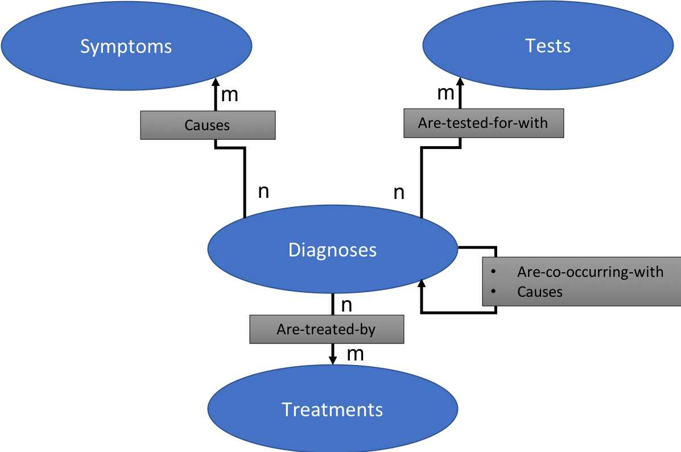
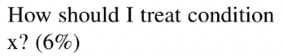
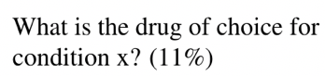
Scope of mini-IIR model
Diagnosis centric model
Clinical questions based on Ely et al.¹ classification of all clinical questions into 69 categories
Top 5 questions account for 40% of all clinical questions
1. Ely JW, Osheroff J a, Gorman PN, Ebell MH, Chambliss ML, Pifer E a, et al. A taxonomy of generic clinical questions: classification study. BMJ. 2000;321(7258):429–32.

Slide 70






Instantiation of model
Use existing tools, i.e. MetaMap¹ and QuickUMLS²
Key components of model:
Relationship Extraction
Relationship Scoring
1. Aronson AR, Lang F-M. An overview of MetaMap: historical perspective and recent advances. J Am Med Informatics Assoc. 2010;17(3):229–36.
2. Soldaini L, Goharian N. Quickumls: a fast, unsupervised approach for medical concept extraction. In: MedIR workshop, sigir. 2016.
Could be any source, e.g. clinical guidelines, EHR
Key components developed in our model

Slide 71
RQ-3: Selected Key Contributions
Theoretical model to resolve medical case-based problems using mini-IIR
﻿Method to resolve medical case-based problems
Novel component method to extract disorder-centric, medical relationships from medical literature
Please refer to Chapter 5

Slide 72

Thesis Overview Diagram
RQ-3
Relationship Scoring
Empirical Evaluation
RQ-3
Relationship Extraction
Empirical Evaluation
Clinical Decision Support
RQ-1
RQ-3
User Study
Instantiation Method
Empirical Evaluation
RQ-3
Case-Based Problem Resolution Model
RQ-4(i): ﻿﻿How effective are the methods that implement the components of the model for minimal interaction IR?
Information Retrieval Theory
Multiple Interaction IR
Minimal Interaction IR
RQ-2
Bridging Information Retrieval Conceptual Framework
Notes:
The diagram shows the two domains that this thesis operates within – IR and CDS
40 minutes is insufficient to cover the entire thesis in detail, so I am going to provide you with the research questions, together with the findings and contributions up front and then we will take a more detailed look into two specific areas.
The thesis begins here (click)

Slide 73

Thesis Overview Diagram
RQ-3
Relationship Scoring
Empirical Evaluation
RQ-3
Relationship Extraction
Empirical Evaluation
Clinical Decision Support
RQ-1
RQ-3
User Study
Instantiation Method
Empirical Evaluation
RQ-3
Case-Based Problem Resolution Model
Highlights of relationship extraction method
Information Retrieval Theory
Multiple Interaction IR
Minimal Interaction IR
RQ-2
Bridging Information Retrieval Conceptual Framework
Notes:
The diagram shows the two domains that this thesis operates within – IR and CDS
40 minutes is insufficient to cover the entire thesis in detail, so I am going to provide you with the research questions, together with the findings and contributions up front and then we will take a more detailed look into two specific areas.
The thesis begins here (click)

Slide 74
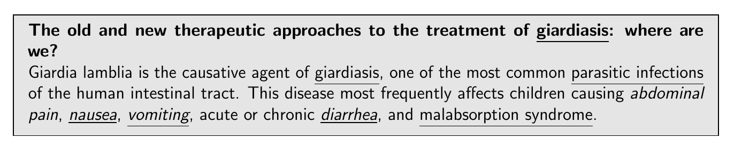



Relationship Extraction Component
Medical Evidence: Medline Abstract, PMID=19707415
Title in bold
We need to identify relationships in medical evidence
Medical concepts extracted with MetaMap - underlined
Many of the disorder centric relationships occur across sentence borders
Notes:
relationships between

Slide 75
Prior Work
Typically used sentence syntax, such as shortest dependency path (SDP), to identify relationships^{1,2,3}
But these models have problems working across sentence borders⁴
We recast the problem as a binary classification of relationship detection between two known medical concepts
Yan X, Mou L, Li G, Chen Y, Peng H, Jin Z. Classifying Relations via Long Short Term Memory Networks along Shortest Dependency Path. In: proceedings of the 2015 conference on empirical methods in natural language processing [Internet]. 2015. p. 1785–94. Available from: http://arxiv.org/abs/1508.03720
Li F, Zhang M, Fu G, Ji D. A neural joint model for entity and relation extraction from biomedical text. BMC Bioinformatics. 2017;18(1):198.
Gupta P, Rajaram S, Schütze H, Andrassy B, Runkler T. Neural relation extraction within and across sentence boundaries. arXiv Prepr arXiv181005102. 2018;
Mehryary F, Björne J, Pyysalo S, Salakoski T, Ginter F. Deep learning with minimal training data: TurkuNLP entry in the BioNLP shared task 2016. In: Proceedings of the 4th BioNLP shared task workshop. 2016. p. 73–81.
Notes:
25 mins to here

Slide 76

Relationship Extraction Method
Pre Sentence
Title
Target Sentence
Select next window of two sentences + title
Identify target medical concept in target sentence
Identify first candidate relationship medical concept in title
Are these related?
Identify next candidate...
Candidate One:
giardiasis (title)
giardiasis (pre)
parasitic infections (pre)
abdominal pain (target)
nausea (target)
vomiting (target)
diarrhea (target)
malabsorption syndrome (target)
Target Medical Concept
Candidate Three:
parasitic infections (pre)
abdominal pain (target)
nausea (target)
vomiting (target)
diarrhea (target)
malabsorption syndrome (target)
Need binary labels for each of these candidate relationships
Candidate Two:
giardiasis (pre)
parasitic infections (pre)
abdominal pain (target)
nausea (target)
vomiting (target)
diarrhea (target)
malabsorption syndrome (target)
Candidate four:
abdominal pain (target)
nausea (target)
vomiting (target)
diarrhea (target)
malabsorption syndrome (target)
Candidate seven:
diarrhea (target)
malabsorption syndrome (target)
Notes:
relationships between

Slide 77
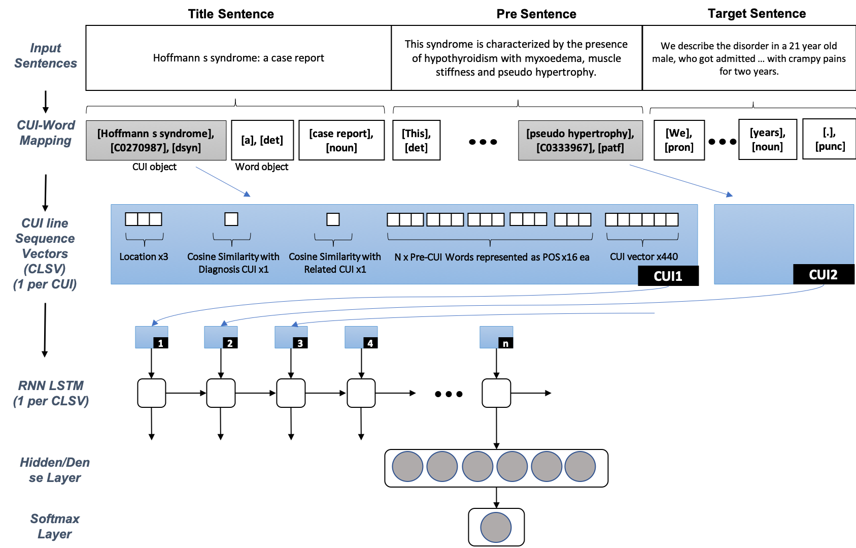






Our disorder-centric, inter-sentence, relationship Extraction Model
Candidate One:
giardiasis (title)
giardiasis (pre)
parasitic infections (pre)
abdominal pain (target)
nausea (target)
vomiting (target)
diarrhea (target)
malabsorption syndrome (target)
Does relationship exist?
Feature vector x 8
For each concept between the candidate relationship – build a set of sequence vectors
Feature vector for each concept between the candidates:
location
cos similarity
POS of pre-words
semType (embedding)
concept (embedding)
Use a Recurrent Neural Network (RNN) Long-short-term-memory (LSTM)¹ to capture the sequence between the two candidate medical concepts
Dense layer = fully connected feed forward layer
Output = binary label: relationship or not?
1. Greff K, Srivastava RK, Koutn’ik J, Steunebrink BR, Schmidhuber J. LSTM: A search space odyssey. IEEE Trans neural networks Learn Syst. 2017;28(10):2222–32.

Slide 78
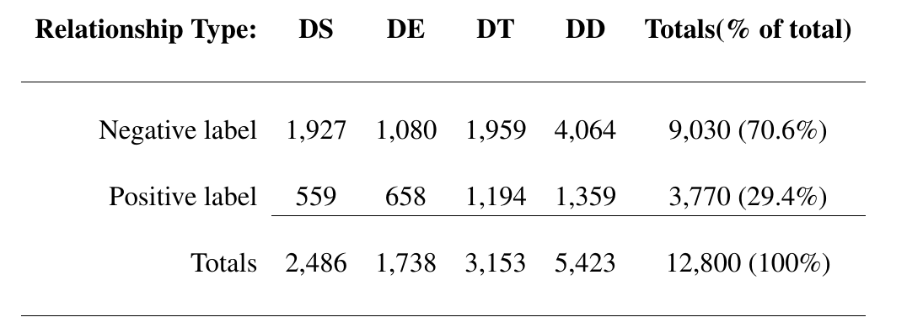


Training & Evaluation Labelled Data Test Set
Disorder-Symptom
Disorder-Treatment
Disorder-Test
Disorder-Disorder
Strong negative bias
Constructed using Crowdsourcing
Silver data set – not validated with clinicians
58% inter-sentence, 42% intra-sentence

Slide 79
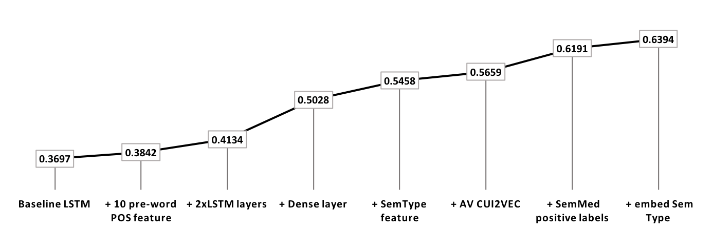
Model Configuration Testing
F1-score Results for System Configuration Trials
80%/20% train/test split
5-fold cross validation for final system

Slide 80
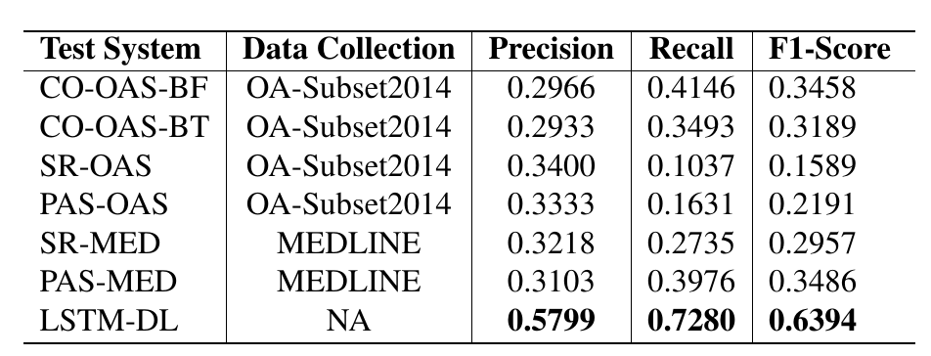


Comparison with prior benchmarks
Evidence Data Sources:
OAS = Open Access Subset of MEDLINE (~700K docs)
MEDLINE = ~20m docs
That’s close to 100% intra-sentence recall (42%)
Benchmarks:
Co-occurence (CO)
SemRep¹ (SR)
Rule based method utilising domain knowledge
PASMED² (PAS)
Sentence grammar/syntax to extract relationships
Inter-sentence model
+71%
+76%
+83%
Inter-sentence model offers significant advantage over intra-sentence models
1. Kilicoglu H, Shin D, Fiszman M, Rosemblat G, Rindflesch TC. SemMedDB: a PubMed-scale repository of biomedical semantic predications. BIOINFORMATICS. 2012;28(23):3158–60.
2. Nguyen NTH, Miwa M, Tsuruoka Y, Chikayama T, Tojo S. Wide-coverage relation extraction from MEDLINE using deep syntax. BMC Bioinformatics. 2015;16(1):107.

Slide 81
RQ-4(i): Key Findings & Contributions
Inter-sentence relationship extraction is superior to other methods
﻿Domain knowledge representation is key model feature
Creation of new MEDLINE wide semType and concept embeddings
Please refer to Chapter 7

Slide 82

Thesis Overview Diagram
RQ-3
Relationship Scoring
Empirical Evaluation
RQ-3
Relationship Extraction
Empirical Evaluation
Clinical Decision Support
RQ-1
RQ-3
User Study
Instantiation Method
Empirical Evaluation
RQ-3
Case-Based Problem Resolution Model
RQ-4 (ii): ﻿﻿How effective is the overall minimal interaction IR system that draws from SML at answering clinical questions?
Information Retrieval Theory
Multiple Interaction IR
Minimal Interaction IR
RQ-2
Bridging Information Retrieval Conceptual Framework
Notes:
The diagram shows the two domains that this thesis operates within – IR and CDS
40 minutes is insufficient to cover the entire thesis in detail, so I am going to provide you with the research questions, together with the findings and contributions up front and then we will take a more detailed look into two specific areas.
The thesis begins here (click)

Slide 83
Empirical Study: Answer Retrieval
Task: To identify and rank the correct answer to 60 diagnosis-based medical cases
Assess impact of relationship extraction, scorers, quantity of evidence used and case format
Compare with benchmark Relationship Extraction Methods: SemRep, PASMED & Co-occur

Slide 84


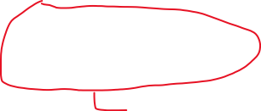


RQ-4(ii): Key Findings & Contributions
Baseline Results: * Correct answer found for 9 in 10 cases * Top 5 ranking for 4 in 10 cases
LSTM is best relationship extraction model when compared with existing methods
New baselined mini-IIR medical answer retrieval system
﻿Relationship extraction is a significant factor for medical answer retrieval
Scoring is not a significant factor, but when combined with PRF it is
Quantity of evidence available is a significant factor: the more the better
Redundancy bias is a key challenge
Redundancy bias: When the quantity of popular relationships in evidence, bias the answers retrieved
Please refer to Chapter 8

Slide 85

Thesis Overview Diagram
RQ-3
Relationship Scoring
Empirical Evaluation
RQ-3
Relationship Extraction
Empirical Evaluation
Clinical Decision Support
RQ-1
RQ-3
User Study
Instantiation Method
Empirical Evaluation
RQ-3
Case-Based Problem Resolution Model
RQ-4 (iii): ﻿﻿And, how does it compare with multi-interaction IR systems, i.e., document retrieval systems?
Information Retrieval Theory
Multiple Interaction IR
Minimal Interaction IR
RQ-2
Bridging Information Retrieval Conceptual Framework
Notes:
The diagram shows the two domains that this thesis operates within – IR and CDS
40 minutes is insufficient to cover the entire thesis in detail, so I am going to provide you with the research questions, together with the findings and contributions up front and then we will take a more detailed look into two specific areas.
The thesis begins here (click)

Slide 86
Multi-IIR vs Mini-IIR: Clinical decision making
Ultimate comparison is another user study
But not ready yet: research required on content, presentation and layout of the information card, e.g. # answers to show? extra evidence required? integration with SERP?
Comparison of metrics?
How to you compare a ranked list of answers with a ranked list of documents?
No reasonable approach exists right now – perhaps economic measures
Final result
Thesis V2: The sequel
Provided foundation for a wide range of extensions: methods, models and evaluation
UQ research group
UQ research group

Slide 87

Contributions and Concluding Remark
Plus important wider findings relating to the relative importance of system effectiveness and document interpretation
Making good clinical decisions is at the heart of patient care and efficient and effective healthcare systems
Our study established that time pressure undermines the ability of medical document search systems to help clinicians
established a broad ir conceptual framework to support and distinguish between multiple & minimal interaction IR systems
provided the theoretical and empirical foundations for a new mini-IIR model to resolve medical case-based problems
taken the first steps towards helping time pressured clinicians to make better clinical decisions
﻿van der Vegt A, Zuccon G, Koopman B, Deacon A. Impact of a Search Engine on Clinical Decisions Under Time and System Effectiveness Constraints: Research Protocol. JMIR Res Protoc 2019;8(5):e12803.

Slide 88
Contributions and Concluding Remark
Currently the only framework targeted at rapidly growing area of IR: mobile and voice response search
Making good clinical decisions is at the heart of patient care and efficient and effective healthcare systems
Our study established that time pressure undermines the ability of medical document search systems to help clinicians
established a broad ir conceptual framework to support and distinguish between multiple & minimal interaction IR systems
provided the theoretical and empirical foundations for a new mini-IIR model to resolve medical case-based problems
taken the first steps towards helping time pressured clinicians to make better clinical decisions
﻿van der Vegt A, Zuccon G, Koopman B, Bruza P. A task completion framework to support single-interaction IR research. Journal of Documentation. 2018 Mar 12;74(2):289-308.

Slide 89
Contributions and Concluding Remark
Including a superior inter-sentence relationship extraction method, new concept embeddings, new labelled data collection and base-lined answer retrieval system
Making good clinical decisions is at the heart of patient care and efficient and effective healthcare systems
Our study established that time pressure undermines the ability of medical document search systems to help clinicians
established a broad ir conceptual framework to support and distinguish between multiple & minimal interaction IR systems
provided the theoretical and empirical foundations for a new mini-IIR model to resolve medical case-based problems
taken the first steps towards helping time pressured clinicians to make better clinical decisions
﻿van der Vegt A, Zuccon G, Koopman B, Learning Inter-Sentence, Disorder-Centric, Biomedical Relationships
from Medical Literature, submitted to AMIA'19 Proceedings on 14th June 2019.

Slide 90
Contributions and Concluding Remark
Making good clinical decisions is at the heart of patient care and efficient and effective healthcare systems
Our study established that time pressure undermines the ability of medical document search systems to help clinicians
established a broad ir conceptual framework to support and distinguish between multiple & minimal interaction IR systems
provided the theoretical and empirical foundations for a new mini-IIR model to resolve medical case-based problems
taken the first steps towards helping time pressured clinicians to make better clinical decisions
We are cautiously optimistic that minimal interaction IR systems will be integral to future medical search systems for time pressured clinicians

Slide 91
Contributions and Concluding Remark
Currently the only framework targeted at rapidly growing area of IR: handheld and voice response search
Making good clinical decisions is at the heart of patient care and efficient and effective healthcare systems
Our study established that time pressure undermines the ability of medical document search systems to help clinicians
established a broad ir conceptual framework to support and distinguish between multiple & minimal interaction IR systems
provided the theoretical and empirical foundations for a new mini-IIR model to resolve medical case-based problems
taken the first steps towards helping time pressured clinicians to make better clinical decisions
We are cautiously optimistic that minimal interaction IR systems will be integral to future medical search systems for time pressured clinicians

Slide 92
Thesis Overview Diagram
RQ-3
Relationship Scoring
Empirical Evaluation
RQ-4
RQ-3
Relationship Extraction
Empirical Evaluation
Clinical Decision Support
RQ-4
RQ-1
RQ-3
RQ-3
User Study
Model
Instantiation Method
Empirical Evaluation
RQ-4
Multiple Interaction IR
Minimal Interaction IR
Information Retrieval
RQ-2
Bridging Information Retrieval Conceptual Framework
Notes:
Armed with this knowledge – we sought out a new IR framework to help clinicians to answer their questions faster, with less documentation. We sought out a mini-IIR approach.

Slide 93
Summary of Primary Contributions
Study to explain the impact of time pressure on clinicians and why document retrieval is not effective
Broad Research framework: that supports both mini and multi-IIR
Theoretical model to resolve disorder-centric clinical questions
Methods to instantiate the theoretical model
Novel cross-sentence, disorder centric relationship extraction method
Answer retrieval empirical analysis, identification of key factors and baseline set of results

Slide 94
Round-up conclusion
RQ4(ii)
Answer retrieval: end result using LSTM
challenge: redundancy bias -> scorers couldn’t fix it, but have more ideas
RQ 4(iii)
how do you compare apples with oranges? further study, batch?
economic models: time/accuracy – use BI
Further work required to compare in another study – best method
Need to know content of card, presentation format and layout
What we have done:
Laid foundation for taking the first steps into mini-IIR
Study to explain why time pressured clinicians don’t use and why not so effective and why failed
Research framework: that straddles both mini and multi-IIR
Theoretical Model for disorder-centric questions
Methods to instantiate model
Novel cross-sentence, disorder centric relationship extraction model
Answer retrieval empirical analysis and important factors – baseline set of results
We have methods to improve existing
identify key challenge
This is broader than clinical – much can be used for broader information search problems where time and knowledge are limited
But we are cautiously optimistic that mini-IIR methods will be integrated into medical search

Slide 95
overall answer retrival 5 mins
Highlight go on to use the RE model as one of 4
Test with cases to find answers
Metrics are success etc
Factors are scorers, re models, data sources, case format
Highlight important factors
Highlight overall results
Key challenges

Slide 96
Conclusions, future steps, key contributions (5 mins)
Mini vs multi – the battle rages on. Not really
Really can’t compare without another user study – but not ready for that yet
mini- for some questions – can help considerably
it’s likely to be an integrated approach: but requires more research
Lots of improvement areas identified (opportunity matrix)
Key contributions
major
minor
Conclusion
We expect to see mini and multi together to improve the effectiveness for time pressured clinicians. Recognising they were time pressured and the impact this has on their ability to use search systems was a critical first step. then getting a system to a baseline state of effectiveness was an excellent first step – plus a broader framework to support all mini-IIR research, not just

Slide 97

Our disorder-centric, inter-sentence, relationship Extraction Model
2. ’crampy pains’ = medical concept in target sentence
In a window of 3 sentences: Target, pre-sentence and title
Identify a medical concept in target sentence and either the title or a pre-sentence

Slide 98
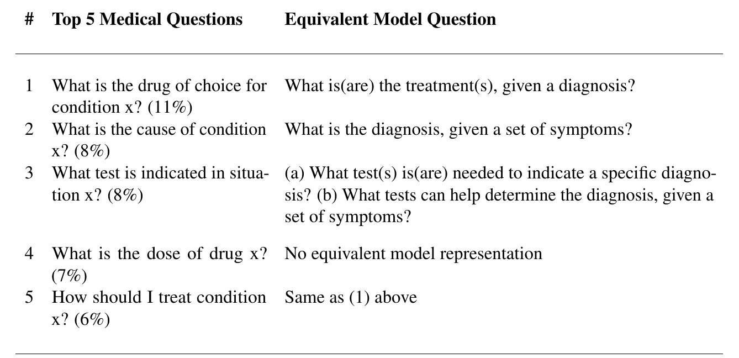
Scope of Answer Retrieval Model
Based on Ely et al.¹ classification of all clinical questions into 69 categories
Top 5 questions account for 40% of all clinical questions
1. Ely JW, Osheroff J a, Gorman PN, Ebell MH, Chambliss ML, Pifer E a, et al. A taxonomy of generic clinical questions: classification study. BMJ. 2000;321(7258):429–32.

Slide 99
Impact of high time pressure on search behaviours
Increased search time, read time and time spent on SERP
Increased # of searches and # documents read
Increased average and maximum search depth
Note: All differences between high and low time pressure levels are significant at each time constraint (TukeyHSD p<.05)

Slide 100


Study Design Method for assessing time pressure
﻿”for the task performer to be time pressured, the time constraint must induce stress such that they feel the need to cope with the limited time” ¹
The search time constraint
Self-reported time pressure at the end of each question
Whether the participant times-out during search
﻿Depending on user and question difficulty – varied time pressure is induced within the same cohort
Similar results
1. Ordonez L, Benson III L. Decisions under time pressure: How time constraint affects risky decision making. Organ Behav Hum Decis Process. 1997;71(2):121–40.

Slide 101
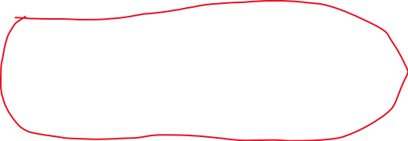
Study Specific Research Questions
﻿RQ-1.1: Does the use of an on-line scientific literature search system enable clinicians to make better clinical decisions?
﻿RQ-1.2: How does time pressure impact clinical decision making?
﻿RQ-1.3: Does a significantly better search system, as measured by standard Information Retrieval (IR) evaluation measures, translate to better and faster clinical decisions?

Slide 102
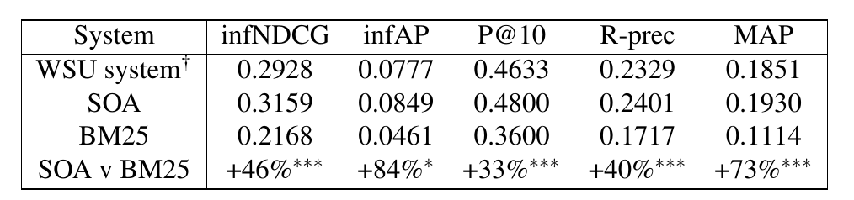
State of Art (SOA) Retrieval Algorithm
Simpson MS, Voorhees EM, Hersh W. Overview of the TREC 2015 Clinical Decision Support Track. Proc Twenty-Third Text Retr Conf TREC 2014. 2014;2:1–8.
Balaneshin-kordan S, Kotov A, Xisto R. WSU-IR at TREC 2015 Clinical Decision Support Track: Joint Weighting of Explicit and Latent Medical Query Concepts from Diverse Sources. Proc 2015 Text …. 2015;3625593.
Built upon WSU’s best TREC 2015 CDS retrieval algorithm^{1,2}
Adds new PRF term weighting model and removes negated query terms
All differences are significant using paired t-test

Slide 103




Impact of Search System Retrieval Performance on Answer Correctness
No significant differences of correct answer rate post-search
The better system results in less participants wrongly changing their answer

Slide 104
Impact of Better Search System
No to minimal Impact on the correct answer rate
Only significantly better for 3 min constraint, Right-to-wrong
No significant impact on the Participant
answer confidence, perceived difficulty and stress
No significant impact on search behaviours
search time, read time, # searches, search depth etc

Slide 105
Thesis Overview Diagram
RQ-3
Relationship Scoring
Empirical Evaluation
RQ-4
RQ-3
Relationship Extraction
Empirical Evaluation
Clinical Decision Support
RQ-4
RQ-1
RQ-3
RQ-3
User Study
Model
Instantiation Method
Empirical Evaluation
RQ-4
Multiple Interaction IR
Minimal Interaction IR
Information Retrieval
RQ-2
Bridging Information Retrieval Conceptual Framework

Slide 106

Research Question RQ-1
Findings
F1.1: Document retrieval systems help clinicians make better clinical decisions
﻿F1.2: Under time pressure the benefit is significantly eroded
﻿F1.3: Better underlying retrieval models have minimal to no impact on the quality or efficiency of clinical decision making
F1.4: ﻿The largest factor influencing clinicians' ability to make correct decisions is their ability to interpret documents
﻿F1.5: High time pressure has a snow-balling affect of undermining both efficiency (time, effort, stress) and efficacy of clinical decision making
How effective are document retrieval solutions, that draw from scientific medical literature, at helping time-pressured clinicians to answer their clinical questions?
User Study
Notes:
I think maybe summarise each into much simpler language

Slide 107

Research Question RQ-2
Findings and Contributions
F2.1: ﻿The key elements of an IR conceptual framework that supports and distinguishes between minimal and multi-interaction search tasks are:
﻿F2.2 ﻿Informing tasks are suited to minimal interaction retrieval. Informing tasks are those for which users neither want, nor must they, perform multi-interaction search in order to complete . A method to determine if a task is informing is provided
﻿Bridging information, i.e. the additional information a searcher requires to complete a task
﻿Searcher's clarity of search task outcomes
﻿Existence of personal preferences
﻿Searcher's desire for interaction
F2.3 ﻿The completion of informing tasks can be satisfied by the provision of the required bridging information with minimal interaction, e.g. via an answer card
F2.4 ﻿A specific type of informing task is a case-based problem solving task. A subset of clinical decision tasks relate to case-based problem solving tasks; and therefore may be supported by minimal interaction retrieval methods
﻿What are the key elements of an IR conceptual framework that supports and distinguishes between minimal and multi-interaction search tasks? How does such a framework inform the design of minimal interaction IR systems?
Bridging Information Retrieval Conceptual Framework
Notes:
Document retrieval does

Slide 108
Perhaps go back to the objective slide
With this in mind
this are the elements of my thesis – big picture slide
then side by side with research question and element highlighted and findings and contributions all in one

Slide 109
then pick out two elements of thesis to showcase in detail
user study – because it’s interesting
Relationship extraction – good results and it gets to the heart of trying to find answers for clinical questions

Slide 110
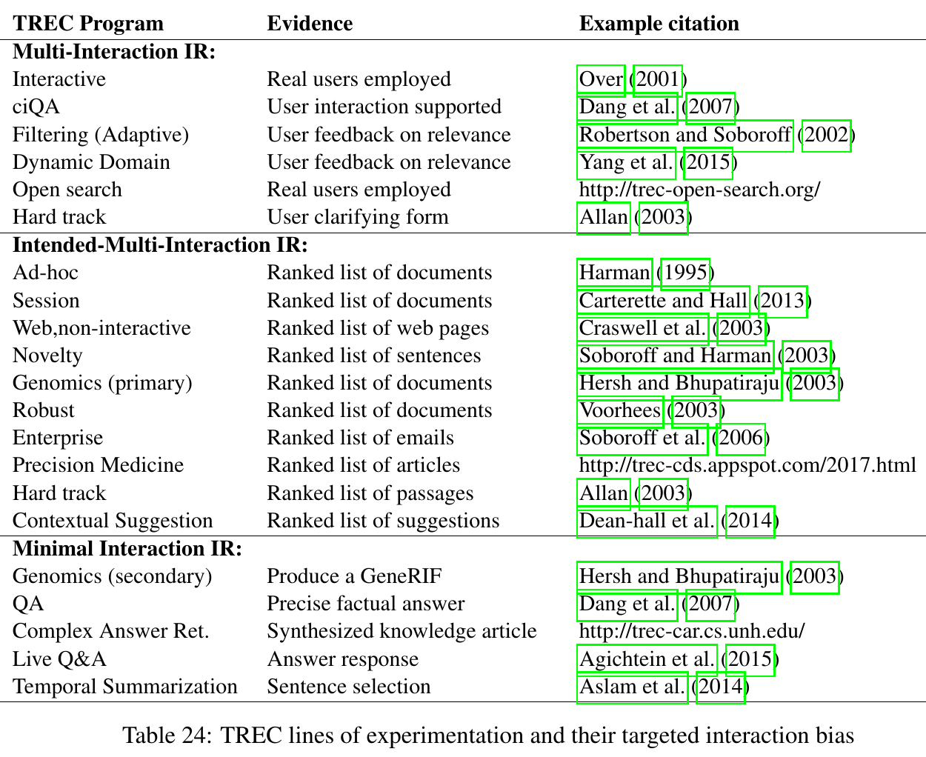
IR Experimental Research: TREC
Text REtrieval Conference is an important IR research challenge series
Majority of research tracks are Multi-IIR
Intended Multi-IIR is batch evaluation targeting an interactive IR user scenario
Experimental IR research primarily uses Multi-IIR methods

Slide 111
IR Theoretical Research
﻿User-oriented approach Schamber L, Eisenberg M, Nilan M. A re-examination of relevance: toward a dynamic, situational definition. Inf Process Manag An Int J. 1990;26(6):755–76. dljfdl
﻿Anomalous State of Knowledge (ASK) Belkin NJ, Oddy RN, Brooks HM. ASK for information retrieval: Part I. Background and theory. J Doc. 1982;38(2):61–71.
Integrated Information Seeking and Retrieval Ingwersen P, Järvelin K. The Turn: Integration of Information Seeking and Retrieval in Context (The Information Retrieval Series). The Turn Integration of Information Seeking and Retrieval in Context The Information Retrieval Series. Dordrecht, the Netherlands: Springer Science & Business Media; 2005. 462 p.
Stratified model of IR interaction Saracevic T. Relevance reconsidered. In: In Proceedings of the 2nd Conference on Conceptions of Library and Information Science. 1996. p. 201–18.
All IR models we found are oriented to multi-IIR

Slide 112
highlight minimal interaction iR – from previous slide
Need to explain this – as it’s a central concept within this thesis
so start with contemporary information retrieval:
most is doc. retrieval
commercial – google, bing example
Clinical – Pubmed –example
In research – mostly doc retrieval – there are differences – explain intended muti-IIR of batch, all models we found – focus on interactive
But minimal –IR is on the rise
small phone size, voice operated – need low/no interaction to work
for info retrieval, this means returning a single answer object (voice, picture, info card – show googles for medical) or
We were motivated to see if mini-IIR has a role to play in improving the effectiveness of clinical decision making
Notes:
before i reveal the research questions, work we did etc – need to
explain an important thread of work in this thesis, which is the touchstone of everything we have done.
minimal interaction IR – what is this?

Slide 113
Plan
7. Motivation and Prior Work (sew the seeds for each area)
3. Big picture (diagram) of work done and map to research questions
Overview of contributions in each area
10. Clinical user study (1 element of big picture)
show in depth the methods, results, analysis, findings, implications
15. Answer retrieval – highlights (2. elements of big picture)
6. RE – lightweight (1 element of big picture)
9. Overall answer retrieval
Method, results, factors, challenges
5. Conclusions and. Implications for future
Can’t compare the two yet: further research into answer cards
expand big diagram with dotted lines to areas of improvement, new clinical study
Re-iterate the contributions
Timely – cautious optimism – better clinical decisions, a framework to support all minimal IR tasks

Slide 114
Intro story
Show up with a case at your gp or in the hospital
Your doctor may or may not know what to make of your case: what your diagnosis is? Which tests to ask for or which treatments to use
They are missing knowledge and they have a clinical question – they arise every 2-3 patients
Without that missing knowledge, they can’t make a decision or they may make a bad decision.
Clinical decisions impact the patient’s health, possibly their survival
Cumulatively, across a healthcare organization – like queensland health, impact the efficiency and effectiveness of the entire system
E.g. Sending out for invalid tests costs money, giving people incorrect treatments can result in poor health outcomes and returning patients – further putting stress on our healthcare systems. Mis-diagnosing may mean that the patient stays in the health system for much longer
But doctors are often very busy
50% of world get 5 minute consultation, 1/3 unhappy about time with patient, too much work
And although the missing knowledge can be found using medical search systems, time pressure is the number one reason for not using such a system
And thus – we have the setting for my research: quote

